Slide 1



International Women's Day
An annual celebration of women's achievements, advocating for gender equality and honoring female contributions worldwide.
by Shweta Choudhary

Slide 2

History and significance of International Women's Day
1
Early Origins
Began in the early 1900s as a part of the movement for women's rights
2
Official Recognition
Formally established as International Women's Day in 1911
3
Global Celebration
Now celebrated worldwide to honor the social, economic, cultural, and political achievements of women

Slide 3

Theme for this year's International Women's Day
Equality for All
Empowerment
Inclusive Leadership
Advocating for gender equality in all aspects of life
Empowering women to reach their full potential
Promoting inclusive leadership and decision-making

Slide 4
Achievements and Progress for Gender Equality
Promoting Equal Pay
Leadership Diversity
Legislation and workplace initiatives for pay parity
Increasing women in leadership positions
Transparent salary structures and gender audits
Boardroom representation and quotas

Slide 5

Challenges and barriers that still exist
Lack of access to education and resources for women
Gender-based violence and discrimination
Underrepresentation of women in leadership roles

Slide 6



Empowering Women in the Workplace
Collaboration
Professional Development
Equal Pay
Building strong teams for collective success
Continuous learning and career advancement
Ensuring fair compensation for all employees

Slide 7

Promoting Women's Health and Well-being
Access to Healthcare
Mental Health Support
Lack of access to quality healthcare services for women
Addressing mental health issues and providing support
Reproductive Rights
Advocating for reproductive rights and access to resources

Slide 8



Celebrating women's achievements in various fields
Science and Innovation
Entrepreneurship and Leadership
Art and Creativity
Revolutionary discoveries shaping the future
Expressing emotions through innovative art forms
Empowering women to lead and succeed

Slide 9
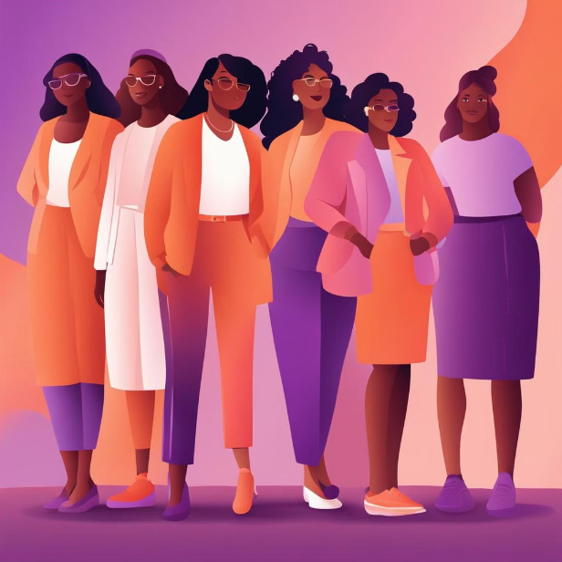
Call to action for gender equality
Empower women through education and leadership opportunities.
Promote equal pay and career advancement for women.
Support policies that ensure gender equality in all areas.

Slide 10

Conclusion and Future Goals for International Women's Day
The future goals for International Women's Day include continuing efforts to achieve gender equality, empowering women in all aspects of life, and advancing women's rights globally.
There is a call for action to eliminate discrimination, create inclusive environments, and promote women's health and well-being. The focus will be on celebrating women's achievements and advocating for equal opportunities in all fields.

Slide 11

Thank you

